Slide 1
Food Donation Management System
Software Design And Architecture

Slide 2
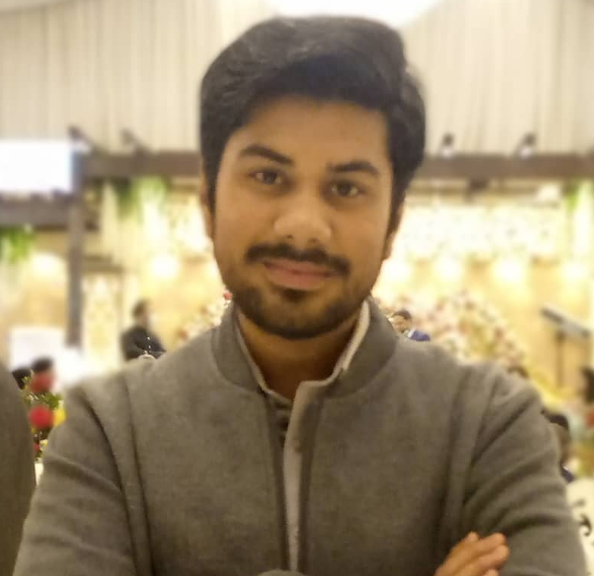
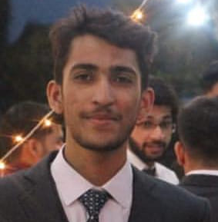
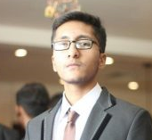
Salman Ahmed Khan 19k-1043 Sadeem Sattar 19k-1102 Abdullah Tilal Khan 19k-1103
Bachelor Of Science Degree
Software Engineering Department – Section A
Batch 2019
National University of Computer and Emerging Sciences, FAST KHI

Slide 3
Introduction
The Food Donation Management System focuses on the difficulties and problems faced while donation.
This automated system provides a better communication between the donor and the receiver of the donation
The system emphasis on the saving of food in the form of donations and reduce the food waste.

Slide 4
Food Wastages Statistics
Some of the statistics from Food and Agriculture Organization of United Nation (FAO) regarding of food wastage around globe are:
The global volume of food wastage is estimated at 1.6 billion tonnes of "primary product equivalents." Total food wastage for the edible part of this amounts to 1.3 billion tonnes.
A low percentage of all food wastage is composted: much of it ends up in landfills, and represents a large part of municipal solid waste. Methane emissions from landfills represents one of the largest sources of GHG emissions from the waste sector.
Americans discard more food than any other country, nearly 40 million tons — or 30-40 percent of the entire US food supply.
UN figures also show that 5.6% of people aged 15 or over struggle to get enough food. A further 4.5% report that they have been a full day without anything to eat.

Slide 5
Why Food Donation System?
This problem is being selected as so much food goes in to wastage.
Due to lack of communication between donor and receiver, the food goes towards wastages.
Many poor and hungry people could not find a food donation which make them go starve.
The system aims to reduce the food shortages in the society. As lot of food got wasted in the parties, marriage ceremonies, birthdays etc. these remaining foods can be donated to a legitimate receiver.

Slide 6
Benefits of the System
The system is automated through which donation receiver can easily order and book the food posted by donor.
It helps to reduce the food wastages in the society.
Through this system, we believe that donating food to the worthy people or organizations helps counter poverty, hunger and at the same time, it can improve harmony, friendliness, and trust among residents.

Slide 7
Primary Users
The system focuses on three primary users.
Donor
Receiver
Admin

Slide 8
Software Development Methodology
The system will be development using Agile Development using Extreme Programming framework.
The advantages of using Extreme Programming
Better for small projects.
Good for the projects with rapidly changing requirements.
It minimizes time and save cost.

Slide 9
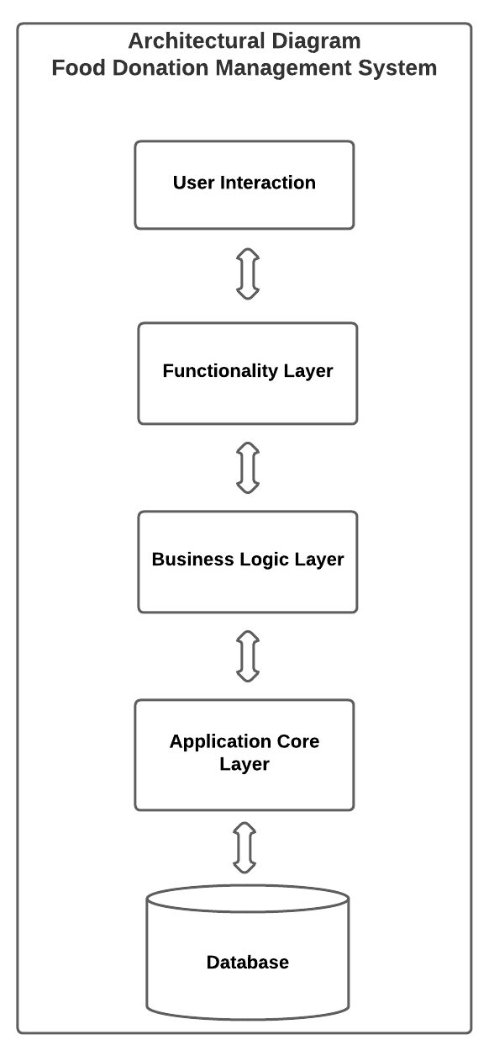
Software Architecture Model
The Layered Architecture will be used as a system software architecture.
The architecture model diagram:

Slide 10
Thank YOU!!
The Project Plan Report, Project Feasibility Report and all Architecture Diagrams are also attached.

